Slide 1
House Prices

Slide 2
About the data set:
The house prices data set is real estate data of medium sized town in New York.
Since the house information is from the same geographical area so in our case location will not impact house values.
The data shows 1047 house’s information that were sold in past 12 months.
Besides the house price (dependent variable) we have 6 other features (independent variables).

Slide 3
About the Features:
The house price data set has following features:
Price – the sale price of the house in $
Living Area – in Sq. ft.
Bathrooms – number of bathrooms in the house (powder rooms with no tub or shower area are considered 0.5 baths)
Bedrooms – the number of bedrooms
Lot Size – size of the property on which the house sits (in acres).
Age – of the house in years
Fireplace – whether or not the house has a fireplace (Yes = 1, No = 0)

Slide 4
Inspiration:
The Motivation behind it I just want to know about the house prices in New York as well as Genpact give me opportunity to complete this task. Genpact is one of my dream company since my academic life. This assignment also enhance my analytical, coding, and modelling skills. I think this is a limited motivation for doing this task well.

Slide 5


Part 1 Prepare a brief report summarizing the home values (prices) in this area. Use graphical summaries. Your report should briefly describe what those summaries tell you, and anything of particular note/interest.

Slide 6
Data Overview:
 | Price | Living Area | Bathrooms | Bedrooms | Lot Size | Age | Fireplace
count | 1047 | 1047 | 1047 | 1047 | 1047 | 1047 | 1047
mean | 163862.13 | 1807.30 | 1.92 | 3.18 | 0.57 | 28.06 | 0.59
std | 67651.56 | 641.46 | 0.64 | 0.75 | 0.78 | 34.90 | 0.49
min | 16858 | 672 | 1 | 1 | 0 | 0 | 0
25% | 112014 | 1336 | 1.5 | 3 | 0.21 | 6 | 0
50% | 151917 | 1672 | 2 | 3 | 0.39 | 18 | 1
75% | 205235 | 2206 | 2.5 | 4 | 0.6 | 34 | 1
max | 446436 | 4534 | 4.5 | 6 | 9 | 247 | 1
Python Code:
data.describe()

Slide 7
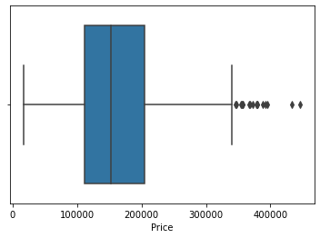
Data Overview:
The minimum value of response variable is 16858 and maximum value is 446436. This gives the idea of range.
The std dev gives the idea of dispersion.

Slide 8
Data Overview:
Python Code:
data.isnull().sum()
Price 0
Living Area 0
Bathrooms 0
Bedrooms 0
Lot Size 0
Age 0
Fireplace 0
dtype: int64
Since the data ‘houseprices’ has no null values. There is no need to clean the data.

Slide 9
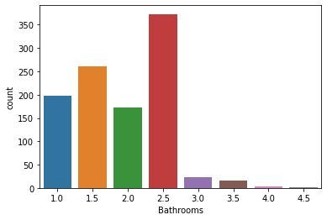
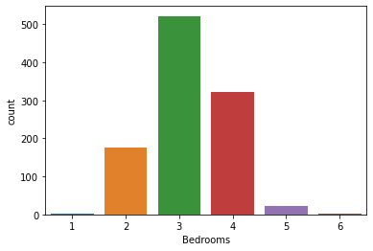
EDA:
Starting the EDA by showing the distributions of each features:

Slide 10
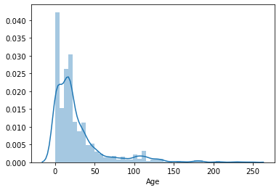
EDA:
Starting the EDA by showing the distributions of each features:

Slide 11
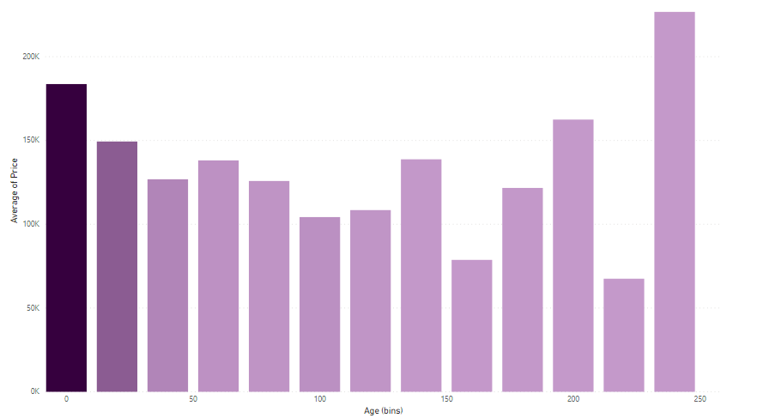
EDA:

Slide 12
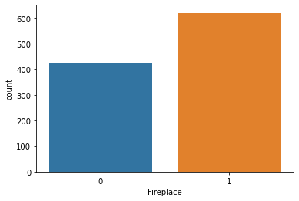
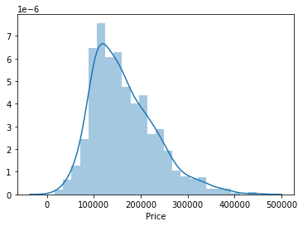
EDA:
Price is right skewed.

Slide 13
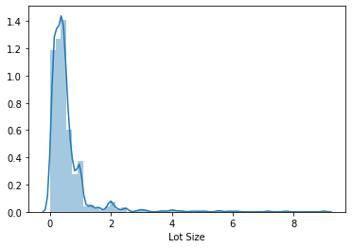
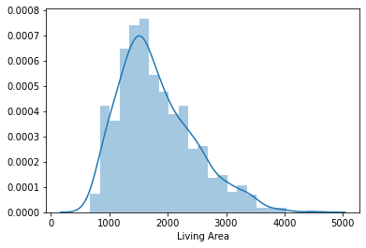
EDA:

Slide 14
Part 2 Describe the relationship of Price with other factors? Conduct a Multiple linear regression to assess the relationship.

Slide 15
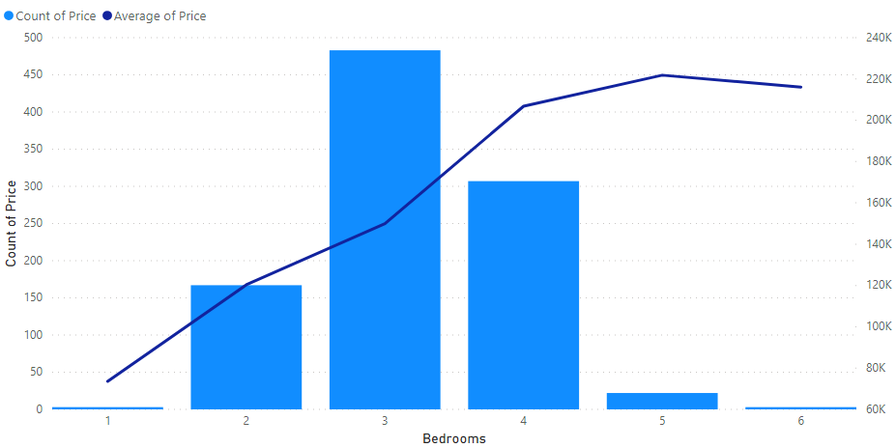
EDA of dependent feature with the independent features:

Slide 16
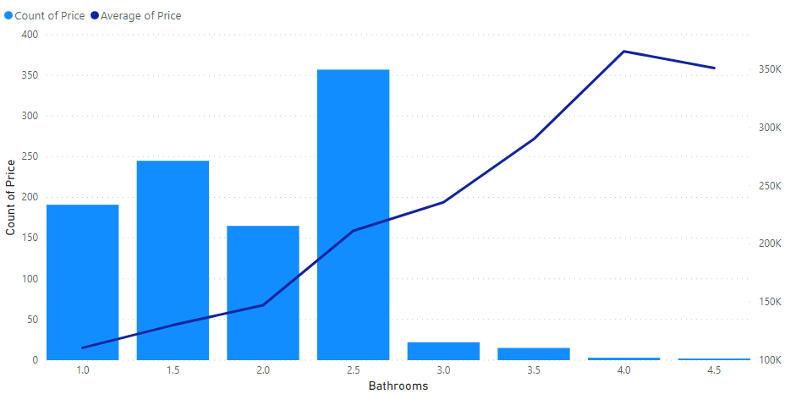
EDA:

Slide 17
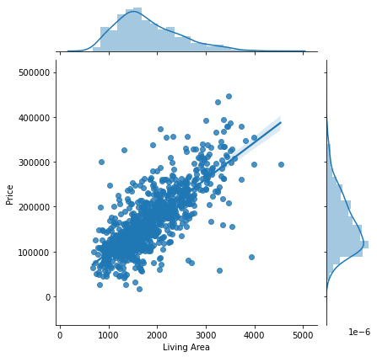
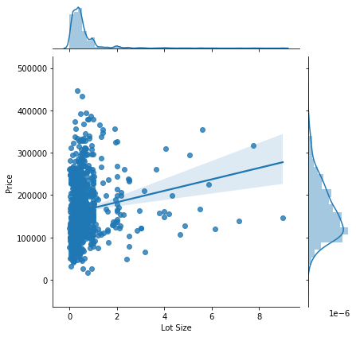
EDA of dependent feature with the independent features:

Slide 18
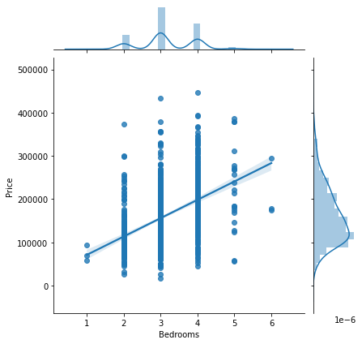
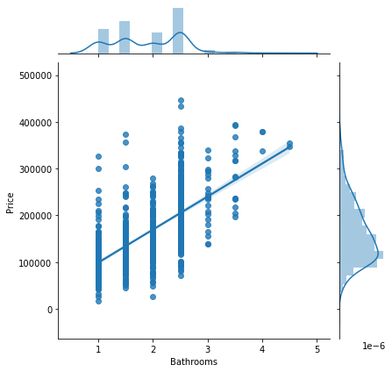
EDA:
Starting the EDA by showing the distributions of each features:

Slide 19
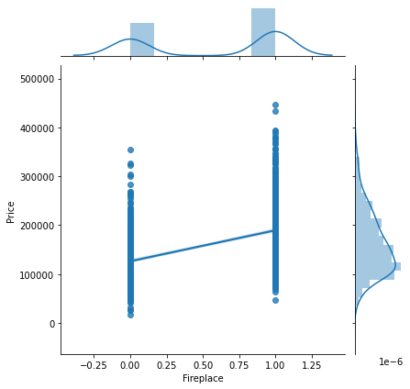
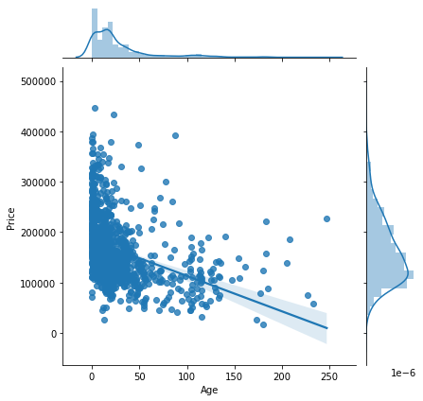
EDA:

Slide 20
Multiple Linear Regression:
The accuracy score of the multiple linear regression model is 63%, which is quite good.
The intercept value is: 2865.5181
The coefficients of the linear regression model are: [ 64.2493, 17834.279 , -3417.3588, 1395.896 , -217.7046, 9517.7328]
Thus, the relationship of House price with other independent variables is:
Price = 2865.52 + 64.25 * (Living Area) + 17834.28 * (Bathrooms) – 3417.36 * (Bedrooms) + 1395.9 * (Lot Size) -217.7 * (Age) + 9517.73 * (Fireplace)

Slide 21
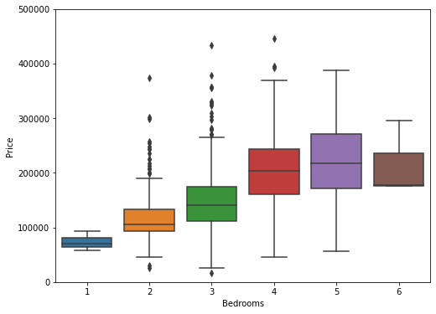
EDA:
Distribution of Number of Bedrooms with Price.

Slide 22
Part 3 Create a histogram and boxplot for the Living Area variable. What does the histogram tell you that the boxplot does not, and vice-versa? Is the distribution symmetric? Check the skewness measure to see if it is consistent with your observation.

Slide 23
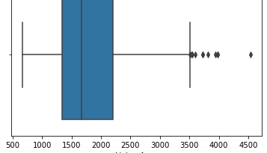
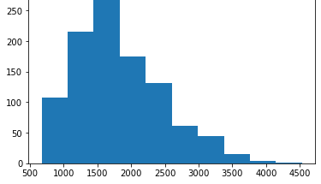
EDA of Living Area:
The living area feature is right skewed. It also has some outliers.
The box plot gives us precise information about the minimum value, the first quartile, the median, the third quartile, and the maximum value. Also, it talks about the outliers. The histogram also tells the distribution of the data but not in exact numerical value. If we increase the number of bins of histogram then it gives deep distribution of data of every bins.

Slide 24
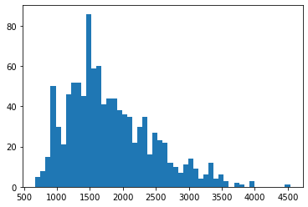
Histogram of living Area when we increase the number of bins:

Slide 25
Correlation:
 | Price | Living Area | Bathrooms | Bedrooms | Lot Size | Age | Fireplace
Price | 1.00 | 0.78 | 0.67 | 0.47 | 0.16 | -0.36 | 0.46
Living Area | 0.78 | 1.00 | 0.72 | 0.66 | 0.20 | -0.26 | 0.48
Bathrooms | 0.67 | 0.72 | 1.00 | 0.49 | 0.10 | -0.44 | 0.44
Bedrooms | 0.47 | 0.66 | 0.49 | 1.00 | 0.14 | -0.06 | 0.30
Lot Size | 0.16 | 0.20 | 0.10 | 0.14 | 1.00 | 0.02 | 0.05
Age | -0.36 | -0.26 | -0.44 | -0.06 | 0.02 | 1.00 | -0.25
Fireplace | 0.46 | 0.48 | 0.44 | 0.30 | 0.05 | -0.25 | 1.00
The highest correlation of Price is Living Area.
The correlation of age with price is negative.

Slide 26

Thank You

